Slide 1

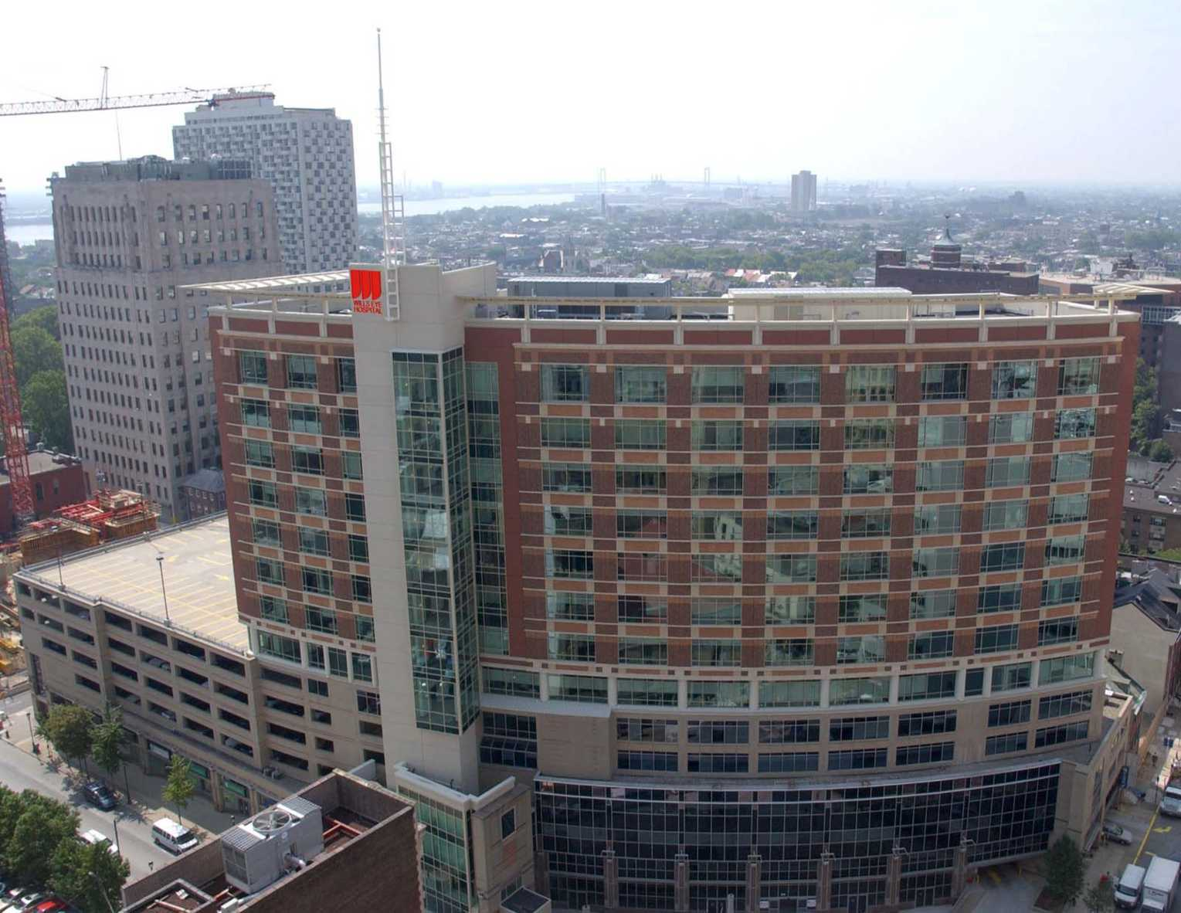
Excimer Laser
Phototherapeutic Keratectomy for Keratoconus Nodules
Ahmad F. Elsahn, M.D.; Christopher J. Rapuano, M.D.; Elisabeth J. Cohen, M.D. and Victor A. Antunes, M.D.
Wills Eye Institute, Philadelphia, PA

Slide 2
BACKGROUND
80% of keratoconus (KCN) patients use RGPs for the correction of their vision.
Apical nodules may reduce CL tolerance and patients often require corneal transplants.
PTK has been demonstrated to be safe and effective for treating anterior corneal pathology.
PTK for KCN Nodules

Slide 3
MATERIALS & METHODS
15 eyes of 15 patients who underwent PTK for KCN nodules with a minimum follow-up of 3 months.
All patients were CL intolerant and showed on SLE an elevated nodule at the apex of the cone.
PTK for KCN Nodules

Slide 4
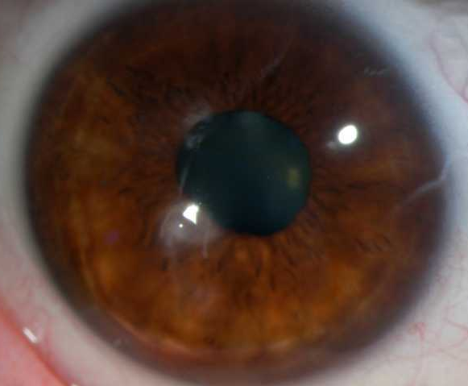
Slit lamp frontal view showing an untreated elevated apical nodule.
PTK for KCN Nodules

Slide 5
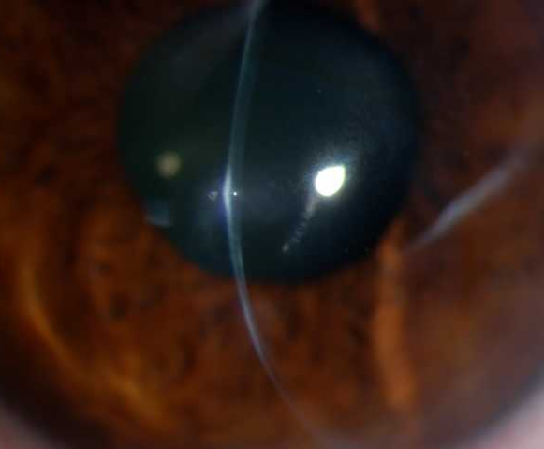
Slit lamp side view of the same nodule
PTK for KCN Nodules

Slide 6
MATERIALS & METHODS
Preoperative BCVA, method of correction and corneal topography were assessed in all patients.
Postoperative pain, epithelial defect size, days to healing, method of correction and visual outcome were evaluated.
PTK for KCN Nodules

Slide 7
PTK PROCEDURE
The epithelium and the bulk of the nodule are removed with a blade.
Excimer laser is used to remove the rest of the nodule and smooth the surface.
Postoperative topical antibiotics and oral pain meds are prescribed to all patients.
PTK for KCN Nodules

Slide 8
Slit lamp frontal view showing an untreated elevated apical nodule.
PTK for KCN Nodules

Slide 9
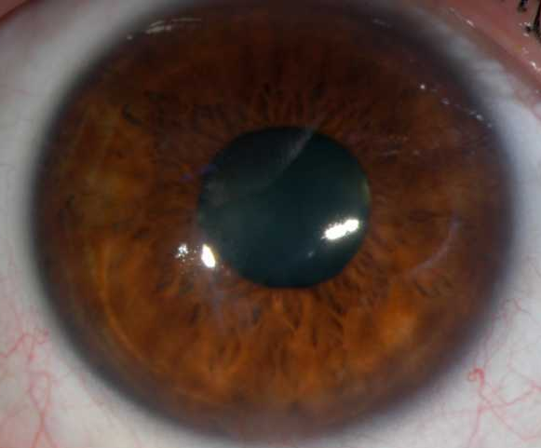
Slit lamp frontal view showing the same nodule 1 week after PTK treatment.
PTK for KCN Nodules

Slide 10
Slit lamp side view of the same nodule before PTK treatment.
PTK for KCN Nodules

Slide 11
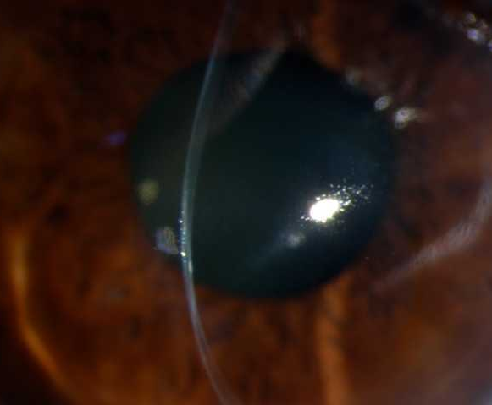
Slit lamp side view of the same nodule 1 week post-operatively.
PTK for KCN Nodules

Slide 12
RESULTS
Mean follow-up time after the first PTK was 23.1 months (SD± 42.5 months, range 3 to 143 months).
11 patients (73.3%) were successfully refitted with CL with an average post-operative BCVA of 20/40.
PTK for KCN Nodules

Slide 13
RESULTS
One patient was happy with her UCVA, but decided recently she wanted an RGP, and is in the process of being refit.
Three patients had recurrences of the KCN nodules first noted 3, 8 and 23 months post-operatively, respectively.
PTK for KCN Nodules

Slide 14
RESULTS
The 1st patient underwent a standard PK.
The 2nd patient has a recurrent nodule but has not decided yet whether to do a repeat PTK or PK.
The 3rd patient had a repeat PTK: BCVA was 20/40, comfort improved and no recurrence was noted at last F/U 55 months after the 2nd PTK procedure.
PTK for KCN Nodules

Slide 15
Table 1. Pre- and final post-operative BCVA.
PTK for KCN Nodules

Slide 16
CONCLUSION
PTK can be successful in improving CL tolerance and occasionally BCVA in patients with KCN nodules.
The nodules typically don’t recur after PTK, and if they do, repeat PTK can be performed with good results.
PTK for KCN Nodules

