Slide 1
Corneal thickness profiles of normal and keratoconic eyes on the Pentacam tomography system
Mehdi Ghajarnia, MD
Mark Mifflin, MD
John A. Moran Eye Center
University of Utah
Salt Lake City, Utah

Slide 2
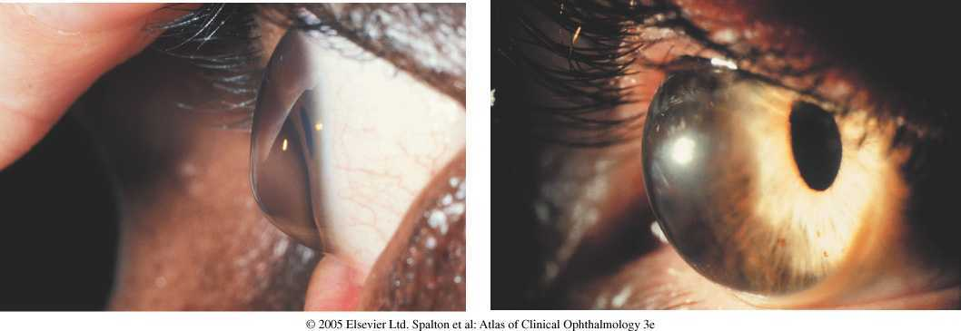
Recognizing Keratoconus:
Relatively common: 50 per 100,000
Presents puberty to 30s
Contraindication for refractive surgery
Forme Fruste KCN is relative contrindication
Classic signs on biomicroscopy
& retinoscopy
Topography guided diagnosis:
-Rabinowitz-McDonnell inferior-superior
dioptric asymmetry (I-S value)
-KISA % based on
central keratometry
I-S value
AST index- quantifies regular corneal astigmatism
skewed radial axis index – measure of irregular astigmatism
-Klyce-Maeda Expert System of Tomey TMS-1 instrument
2-5% of potential refractive patients have features of keratoconus.
Discriminating features are needed to exclude those with KCN and forme fruste KCN to avoid surgically induced ectasia.

Slide 3
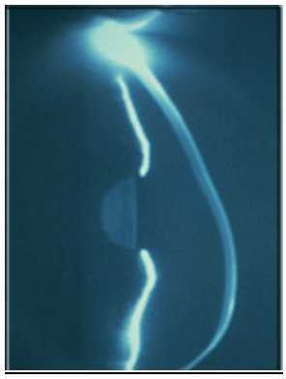
Recognizing Keratoconus & Forme Fruste in refractive candidates
Tomography guided:
Pflugfelder et al. used Orbscan to
differentiate normal vs. keratocnics
by defining:
-corneal thickness index (CTI)
-discrimination function-1 (DF1)
Ambrosio et al. used Pentacam
to describe differences between
normals & keratoconics using:
-corneal thickness spatial profile
-corneal volume distribution
-percent increase thickness/volume

Slide 4
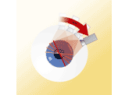
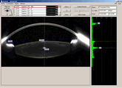
Pentacam Tomography Unit
Scheimpflug imaging
Rotational camera
2 seconds used to capture all images
12-50 single images compiled; 25,000 elevation points measured
Creates topographic and thickness profiles
Best fit sphere concept used to create “float” maps of the anterior and posterior surface

Slide 5
Pentacam Study Goals:
Is there a difference between keratoconus patients versus normals with respect to:
Superior-Inferior corneal thickness ratio & difference
Central-Inferior corneal thickness ratio
Posterior best fit sphere
Volume at 3, 5, and 7 mm zones
Establish statistical normals for Pentacam

Slide 6
Results:
KCN group:
48 eyes of 27 patients
Mean age: 42.9
Control group:
51 eyes of 26 normals
Mean age: 40.8
Steepest K (Diopters):
KCN: 58.5 +/-9.0
Control: 47.5 +/-1.76
Thinnest corneal thickness (microns):
KCN: 456 +/-56
Control: 546 +/-36
In 83% of keratoconic eyes the cone/point of maximal thinning was found in the inferior temporal quadrant.
Best fit sphere (Back Elevation):
KCN: 6.05 +/-0.96
Control: 6.47 +/-0.33

Slide 7
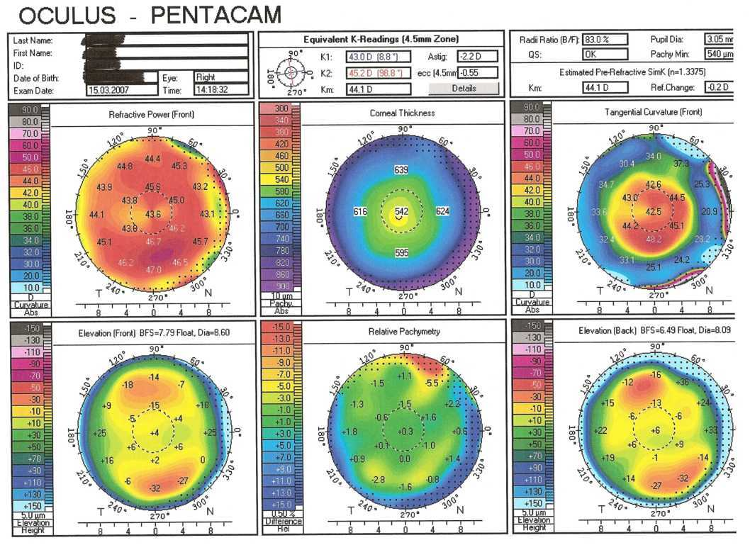
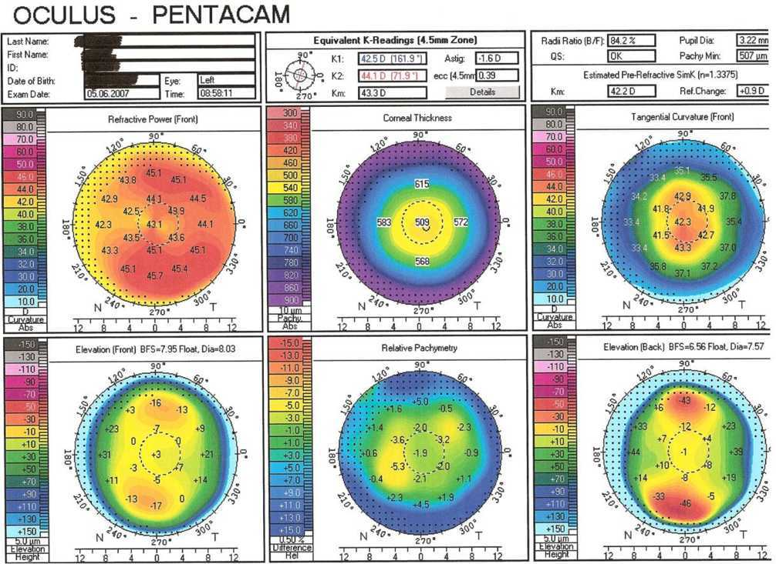
Sample of Pentacam study from a normal patient used for data collection in this study. Volume data was collected from the keratoconic evaluation display.

Slide 8
Results:
Ratio of Superior to Inferior Corneal Thickness:
KCN: 1.15 +/-0.12
Control: 1.07 +/-0.03 p<0.001
Difference between Superior to Inferior Corneal Thickness (in microns):
KCN: 76.3 +/-56.3
Control: 43.7 +/-25.4 p<0.001
Central to Inferior thickness ratio:
KCN: 0.90 +/-0.12
Control: 0.89 +/-0.04 p=0.65
Thickest to thinnest corneal thickness ratio:
KCN: 1.62 +/-0.25
Control: 1.41+/-0.12 p<0.001

Slide 9
Average Corneal Thickness Profiles of NL & KCN Patients (microns)

Slide 10
Pentacam Volume Parameters: Normals vs. KCN
* p<0.001
t P=0.001

Slide 11
Pentacam Study Conclusions:
Using the Pentacam tomography system, characteristic patterns of keratometry & thickness were described in a normal & keratoconic patient population. These were consistent with past observations using other technologies.
Notably, the superior to inferior corneal thickness relationship (S/I) was accentuated in keratoconic eyes & statistically significant.
Contrary to previous findings with Orbscan tomography, no significant difference was found in the central to inferior C/I ratio between these groups.
Volume measurements from the Pentacam system may also be helpful in differentiating keratoconic corneas.
Screening value may be limited because of high variance in the KCN group. Sub-grouping KCN patients with regards to severity may improve analysis & provide more useful information in screening out forme fruste KCN patients from refractive surgery.

Slide 12
References:
1. Pflugfelder SC, Zuguo L, Feuer W, Verm A. Corneal thickness indices discriminate between keratoconus and contact lens-induced corneal thinning. Ophthalmology 2002;109(12):2336-41.
2. Rabinowitz YS. McDonnell PJ. Computer-assisted corneal topography in keratoconus. Refractive and Corneal Surgery 1989;5(6):400-408.
3. Rao SN, Raviv T, Majmudar PA, Epstein RJ. Role of Orbscan II in screening keratoconus suspects before refractive corneal surgery. Ophthalmology 2002 109(9):1642-6.
4. Ambrosio R Jr, Alonso RS, Luz A, Coca Velarde LG. Corneal-thickness spatial profile and corneal-volume distribution: tomographic indices to detect keratoconus. J Cataract Refract Surg 2006 32(11):1851-9.

